Slide 1

The relationship between energy commodities and exchange rates
Seminar in Applied Financial Economics: Applied Econometrics of FX Markets - Professor Reitz
Josef Fella and Robert Hennings
Christian-Albrechts-University of Kiel
josef.fella@stu.uni-kiel.de and robert.hennings@stu.uni-kiel.de
GitHub: https://github.com/RobertHennings
Kiel - 14.11.2025

Slide 2
Chapter 3)
Literature Review

Slide 3
The relationship between Energy Commodity Prices and exchange rates: Transmission channels
Datafrequency
Daily, Weely, Monthly
Monthly, Quarterly
Annually
Timeframe
Short Run Dynamics
Mid-term fluctuations
Long Run Relationship
Relationship Type
Financial Transmission Channels
Macroeconomic Transmission Channels
Fundamental Transmission Channels
Linear
Wealth Transfer Effect
(Risk Parity) Portfolio Rebalancing Effect
Monetary Policy
Present Value Approach
Inflation
Expectation Effects
Oil export and import
Denomination (Numeraire) Effect
Commodity Currencies
Dominant Pricing Effect
Non-Linear
Volatility and Risk Spillover Effects
(US) Terms of Trade Effect
Financialization Effects
Oil price shock affecting exchange rate through two channels (see impact of oil shocks Markov Switching)

Slide 4
Chapter 4)
Methodology Overview

Slide 5
Definitions
Definitions
Main Variables
Real Effective Exchange Rates (REER)
Measuring Price (levels)
Real exchange rates in external terms: CPI/PPI
Nominal Exchange Rates
Real Exchange Rates (RER)
Real exchange rates in internal terms/terms of trade: Ratio tradable and non-tradable goods
Inflation
Nominal Energy commodity prices
Real Energy commodity prices
Spot or Futures Markets (prices)

Slide 6
A simple model of exchange rates and commodity prices
Heavily affect importing and exporting economies
Adjusted Future Expectations for Demand-Supply Levels
(Spot) Price Adjustments
Increased Volatility
Inflationary Pressure driving up prices
Monetary Policy: Hike Rates
Fundamental Shock

Slide 7
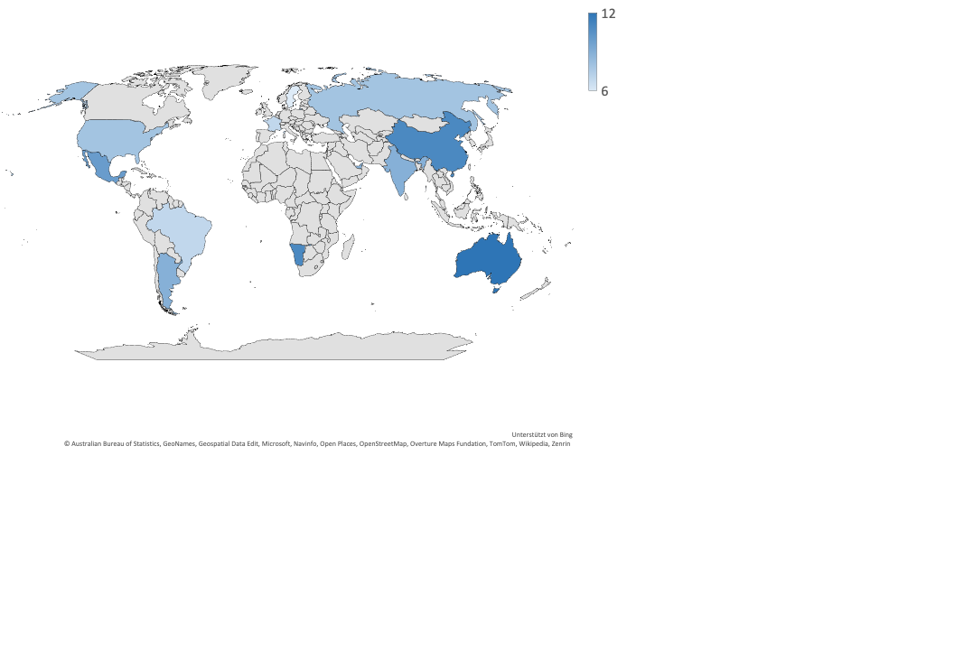
A simple model of exchange rates and commodity prices

Slide 8
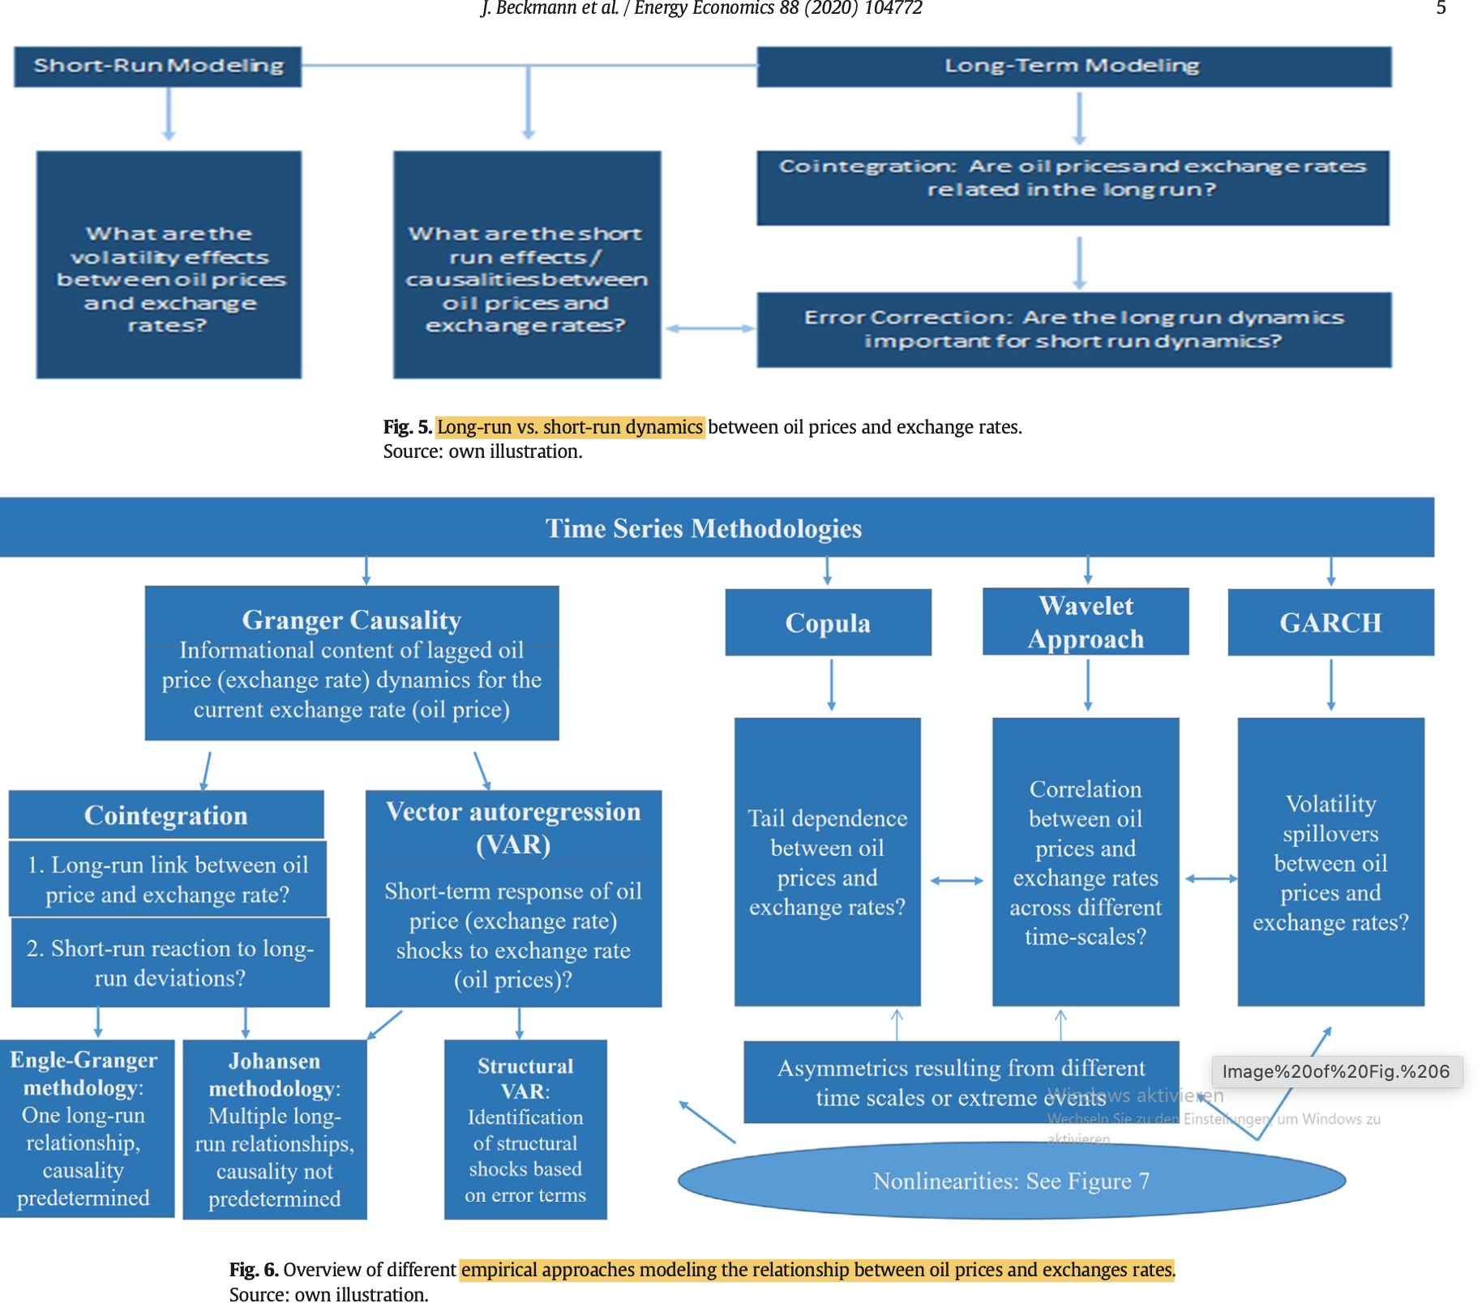
The relationship between Energy Commodity Prices and exchange rates: Transmission channels
Datafrequency
Daily, Weely, Monthly
Monthly, Quarterly
Annually
Timeframe
Short Run Dynamics
Mid-term fluctuations
Long Run Relationship
Relationship Type
Financial Transmission Channels
Macroeconomic Transmission Channels
Fundamental Transmission Channels
Linear
Wealth Transfer Effect
(Risk Parity) Portfolio Rebalancing Effect
Monetary Policy
DCC - GRACH
SVAR
Inflation
VAR
Expectation Effects
Oil export and import
Denomination Effect
Commodity Currencies
Dominant Pricing Effect
Non-Linear
Volatility and Risk Spillover Effects
(US) Terms of Trade Effect

Slide 9
The relationship between Energy Commodity Prices and exchange rates: Econometric modelling
Relationship Type
Linear
Non-linear
Timeframe
Relationship
Correlation
When we find a certain relationship we can proceed further
Linear Pearson Correlation
Non-linear rank correlation
Granger-Causality
Rolling Correlation
ECM
Time-varying causality
Regime Switching
Markov-Switching
MS-VAR
DCC - GRACH
Long Run Relationship
SVAR
Cointegration
Connectedness
VAR
VECM
Vector Autoregression (VAR)

Slide 10
Chapter 5)
Theoretical Framework

